Slide 1
Employee data analysis using Excel
Student name: P. Sakthipriya
Register no: 312214943
Department: commerce
College: Annai veilankanni ‘s college for women
NMID: asunm1483312214943

Slide 2
Project title
Employee performance analysis using Excel .

Slide 3
Agenda
Problem statement
Project overview
End users
Our solution and proportion
Dataset description
Modelling approach
Conclusion.

Slide 4
Problem statement
Accurately evaluate employee performance
Identify strengths, weaknesses, Opportunities and threats (SWOT analysis)
Develop targeted interventions and programs
Inform talent management decisions (promotion, successions)

Slide 5
Project overview
Analysis employee performance data to identify key drivers of performance and areas for improvement
Develop data-driven insights to inform talent management decisions, training programs and leadership development initiatives
Focus on indentifying key predictors of performance, area of improvement and opportunities for growth and development.

Slide 6
Who are the end users?
Line managers
HR business partners
Senior leadership
Employee development teams
Compensation and benefits teams
Telent acquisition teams
Employee

Slide 7
Our solution and it’s value proposition
Solution: Employee AI- employee performance insights
Value proposition:
Identify top performances
PinPoint skill gaps
Enhance employee engagement
Inform data -driven decision
Boost productivity

Slide 8
Dataset Description
Description: This data set contains information on employee performance, demogt, and development activities
Fields:
. Employee ID
. Name
. Job role
. Department
. Performance rating
. Performance level

Slide 9
THE "WOW" In OUR SOLUTION
. Al driven prediction analytics for accurate forecasting and insights.
. Automated performance scoring for unbiased evaluation
. Personalized development plans for targeted growth and improvement
. Intuitive and interactive dashboards for easy visualisation and tracking

Slide 10
MODELLING
Regression Analysis
Decision Tree
Clustering Analysis
Predictive Modeling
Propensity Scoring
Survival Analysis
Network Analysis
Machine Learning Algorithm
Simulation Modelling
Bayesian Network

Slide 11
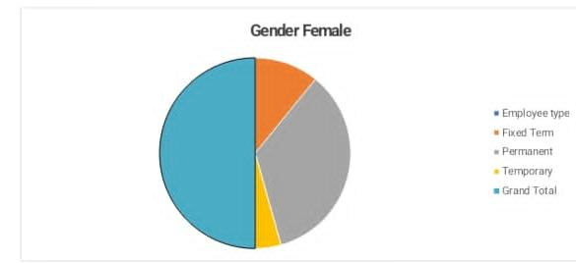
Results

Slide 12
Conclusion
Employee performance analysis is a critical component of talent management, enabling organization to make data driven decision, drive business outputs and enhance employee experience. By leveraging advanced analytics modelling techniques.

